Slide 1
New York City Taxi Trip Duration Prediction

Slide 2
Goals and Aims
Goal:
Develop a model that predicts the trip duration of taxies in NY
Specific Aims:
Data Exploration
Data is available from January to July 2016 with several features
Removing outliers
Exploratory Data Analysis (EDA)
Using histograms, boxplots and bar plots to find trends
Correlation between features and time duration
Feature Engineering and Selection
Adding potential features like the amount of precipitation, rainy/snowy days
Handling categorical and numerical features and select the best features
Building and Evaluating Model
Applying several models
Selecting the best model based on figures of merit (FOM)

Slide 3
Data Summary
id: a unique identifier for each trip
vendor_id: a code indicating the provider associated with the trip record
pickup_datetime: date and time when the meter was engaged
dropoff_datetime: date and time when the meter was disengaged
passenger_count: the number of passengers in the vehicle (driver entered value)
pickup_longitude: the longitude where the meter was engaged
pickup_latitude: the latitude where the meter was engaged
dropoff_longitude: the longitude where the meter was disengaged
dropoff_latitude: the latitude where the meter was disengaged
store_and_fwd_flag: This flag indicates whether the trip record was held in vehicle memory before sending to the vendor because the vehicle did not have a connection to the server - Y=store and forward; N=not a store and forward trip
trip_duration: duration of the trip in seconds

Slide 4
Aim 1: Data Exploration
The dataset does not have any missing values
There are three categorical and two date type columns:
id
vendor_id
Store_and_fwd_flag
Numerical columns are as follows:
passenger_count, pickup_longitude, pickup_latitude, dropoff_longitude, dropoff_latitude, trip_duration
Outliers are in passenger_count and time trip_duration: trip duration less than 10 sec and more than 20 hours, more than 8 passengers
trip_duration is the dependent variable and we try to predict it based on selected features
pickup_datetime
dropoff_datetime

Slide 5
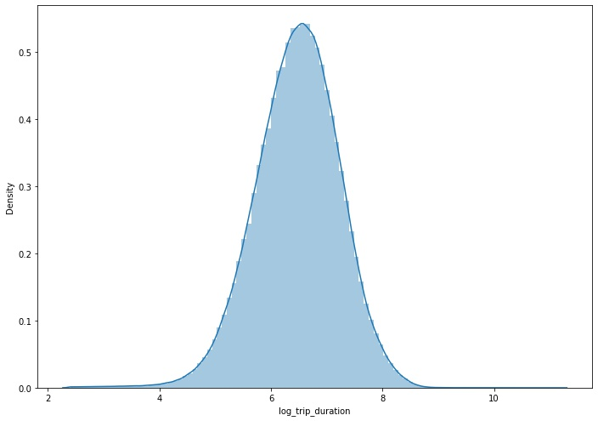
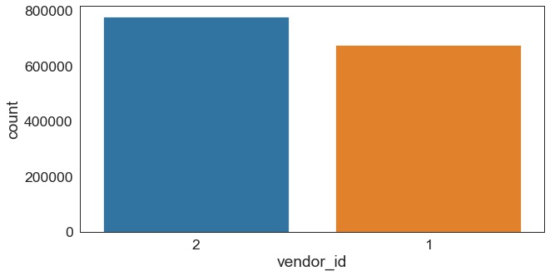
Aim 2:Exploratory Data Analysis (EDA)
Trip Duration
Number of rides for each vendor
Log transformation of trip duration
Vendor 2 has more trips than vendor 1

Slide 6
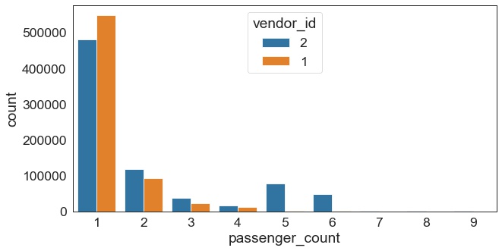
Aim 2: Exploratory Data Analysis (EDA)
Vast majority of rides had only a single passenger
Two passengers is the (distant) second most popular option
There is a smooth decline through 3 to 4
Except single passenger, vendor 2 has more trips than vender 1
Number of passengers in total trips
Considering Vendor_id as a potential feature

Slide 7
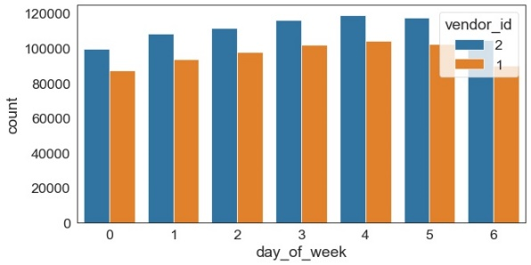
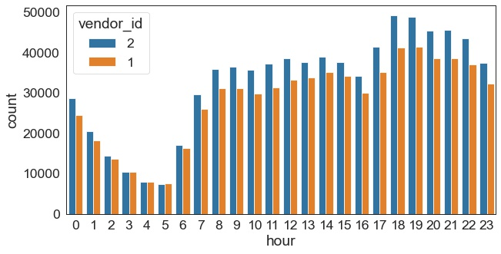
Aim 2: Exploratory Data Analysis (EDA)
Number of trips for each day of the week
Vendor 2 has significantly more trips in this data set than vendor 1.
Monday is the quietest day and Friday is the busiest.
The number of trips are higher in the evening after 5PM until 20 PM and it has the lowest value at 5 AM
Number of trips for 24 hours

Slide 8
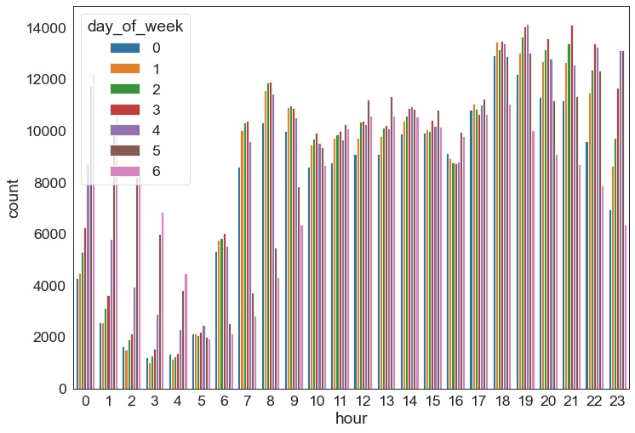
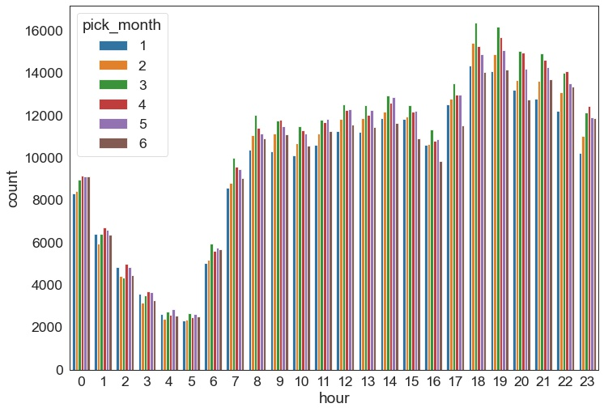
Aim 2: Exploratory Data Analysis (EDA)
Number of trips for 24 hours for each day of the week
The weekend (Sat and Sun, plus Fri to an extend) have higher trip numbers during the early morning hours but lower ones in the morning between 5 and 10 AM
Trip numbers drop on a Sunday evening/night.
January and June have fewer trips, whereas March and April are busier months
Number of trips for 24 hours for each month
The weekday and hour of a trip appear to be important features

Slide 9
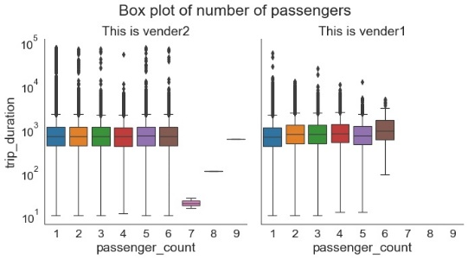
Aim 2: Exploratory Data Analysis (EDA)
There is no significant difference for time duration for different number of passengers and vendors.
Passenger_count might not be an important feature.

Slide 10
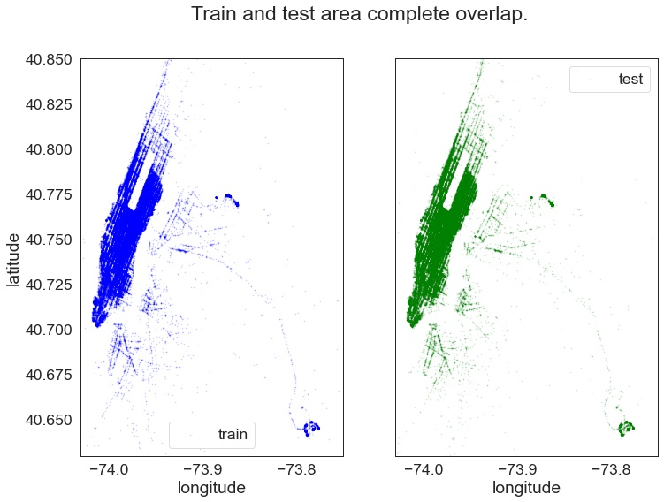
Aim 2: Exploratory Data Analysis (EDA)
Train and test sets overlap completely
it is possible to predict trip duration for test set

Slide 11
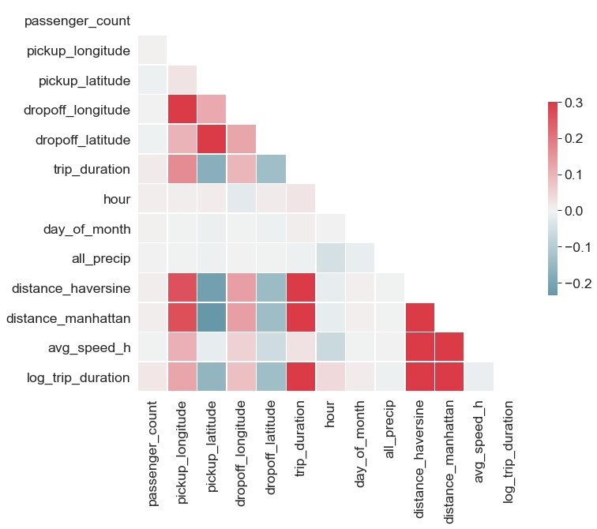
Aim 2: Exploratory Data Analysis (EDA)
The correlation is not strong between trip duration and features.
The strongest correlations (~0.3) are between distances (Manhattan and Haversine) and trip duration.

Slide 12
Aim 3: Feature Engineering and Selection
Categorical Features:
Vendor id
Day of week
Pick up month
Numerical Features:
Hour
Day of month
Latitude and longitude
Number of passengers
Removed Features:
Id
Trip duration

Slide 13
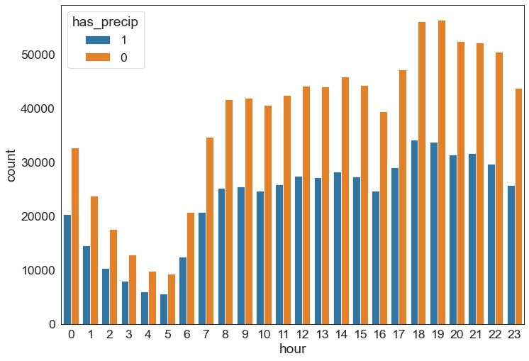
Aim 3: Adding potential features
Haversine and Manhattan distances were calculated
based on pick up and drop off latitude and longitude
From Central Park weather data two features were added
Total amount of precipitation (snow + rain) for each day
If there is precipitation at each day
The new data set needed data cleaning (T means there are some traces of snow or rain)
Number of trips for 24 hours separated by precipitation

Slide 14
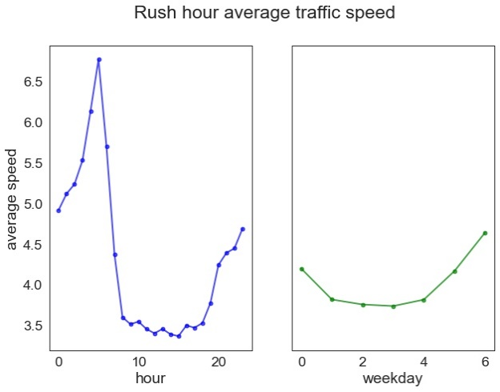
Aim 3: Adding potential features
If the hour is within the highest speed hours (categorical feature)
If the day is week day or weekend (categorical feature)

Slide 15
Aim 4: Building and Evaluating Model
We split the train set into train (80%) and validation (20%) set.
Three models is used for this project:
Linear Regression
XGBoost
Random Forest Regression

Slide 16
Aim 4: Building and Evaluating Model
Evaluation Metrics
Bias: Mean of the difference between predicted and actual trip duration for all samples
Normalized Bias: Mean of the difference between predicted and actual trip duration divided by actual trip duration for all samples. Presented as a percentage.
Error: Mean of the absolute value of the difference between predicted and actual trip duration for all samples.
Normalized Error: Mean of the absolute value of the difference between predicted and actual trip duration divided by actual trip duration for all samples. Presented as a percentage.
R Squared: the proportion of the variation in the dependent variable that is predictable from the independent variables.
Root Mean Squared Logarithmic Error (RMSLE): measure of the differences between predicted and actual trip duration.

Slide 17
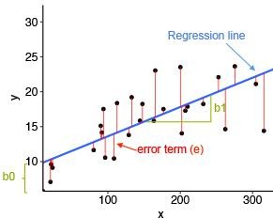

Aim 4: Building and Evaluating Model
Linear Regression Model
regression of dependent variable on independent variable.
assumes a linear relationship between dependent (y) and independent variables (x).
The cost function is given by Mean Squared Error (MSE):
Where:
y_{i} is the i^{th} observed value.
ŷ_{i} is the corresponding predicted value.
n = the number of observations.

Slide 18
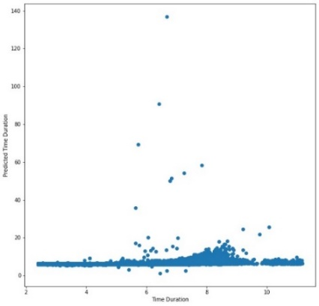
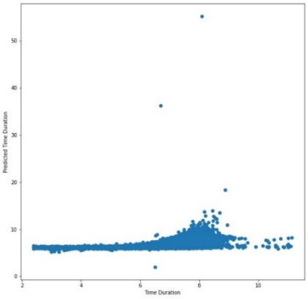
Aim 4: Building and Evaluating Model
Linear Regression Model
R² is relatively low for both train and test sets
Dataset | R² | RMSLE | Bias | Norm_Bias | Error | Norm_Error
Train | 0.365 | 0.602 | -1.49e-15 | 1.0405 | 0.438 | 7.210
Validation | 0.406 | 0.583 | 0.0004 | 1.054 | 0.438 | 7.217
Train Set
Validation Set

Slide 19
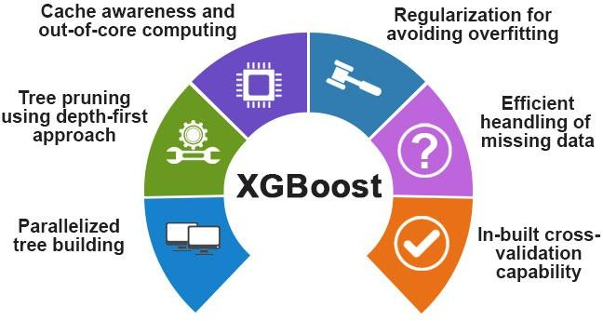
Aim 4: Building and Evaluating Model
XGBoost:
Comes under boosting and is known as extra gradient boosting.
First calculates the model using X and Y then after the prediction is obtain.
It will again calculates the model based on residual of previous model
Loss function will give more weight to error of previous model and continuous until MSE gets minimizes

Slide 20
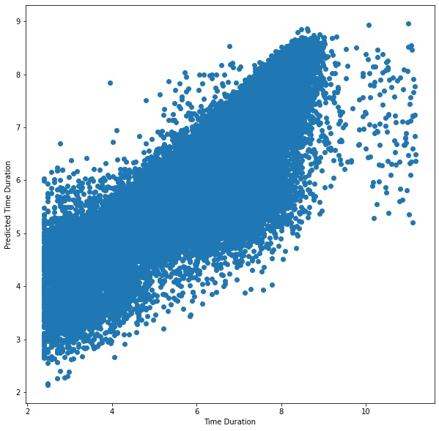
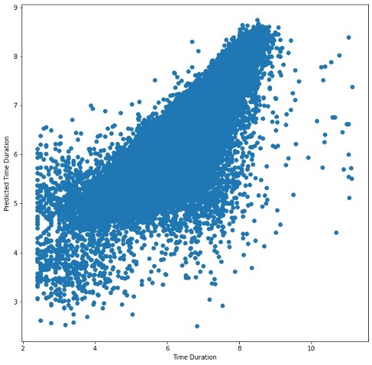
Aim 4: Building and Evaluating Model
XGBoost:
Hyperparameter tuning is done for this model
Normalized bias and error are low and R squared is around 0.8 for both datasets.
The predicted values are in good
agreement to the actual values.
Dataset | R² | RMSLE | Bias | Norm_Bias | Error | Norm_Error
Train | 0.840 | 0.302 | -0.00002 | 0.291 | 0.219 | 3.55
Validation | 0.797 | 0.341 | 0.0008 | 0.363 | 0.236 | 3.866
Train Set
Validation Set

Slide 21
Aim 4: Building and Evaluating Model
XGBoost Feature Importance
Feature_Name | Importance
day_of_month | 0.214118
day_of_week | 0.119769
dropoff_longitude | 0.113163
pickup_longitude | 0.111971
dropoff_latitude | 0.111628
pickup_latitude | 0.111480
passenger_count | 0.111322
pick_month | 0.034971
hour | 0.016167
weekday | 0.011789
vendor_id | 0.009752
distance_haversine | 0.009735
all_precip | 0.007195
fast_hour | 0.006275
distance_manhattan | 0.005924
holiday | 0.004738
has_precip | 0.000000

Slide 22
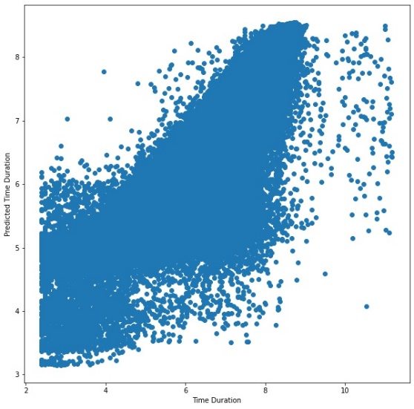
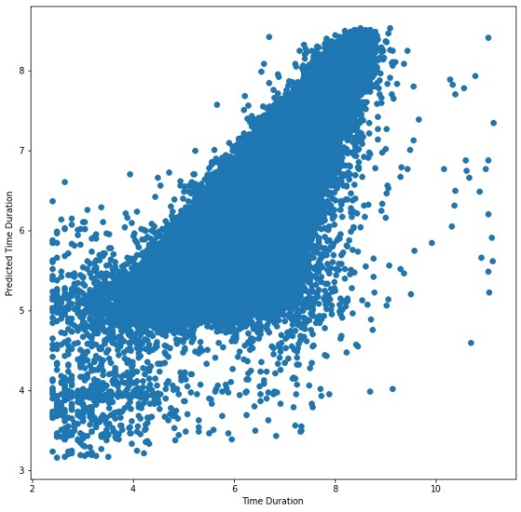
Aim 4: Building and Evaluating Model
Random Forest Regressor
The evaluation metrics are better than Linear regression, but not better than XGBoost
Dataset | R² | RMSLE | Bias | Norm_Bias | Error | Norm_Error
Train | 0.794 | 0.343 | 0.000008 | 0.383 | 0.243 | 3.970
Validation | 0.772 | 0.361 | 0.0004 | 0.411 | 0.256 | 4.191
Train Set
Validation Set

Slide 23
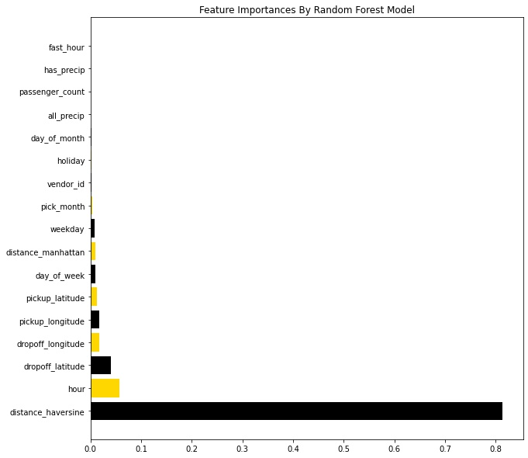
Aim 4: Building and Evaluating Model
Random Forest Feature Importance

Slide 24

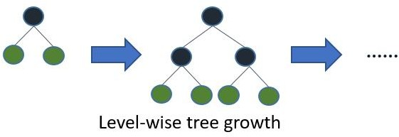
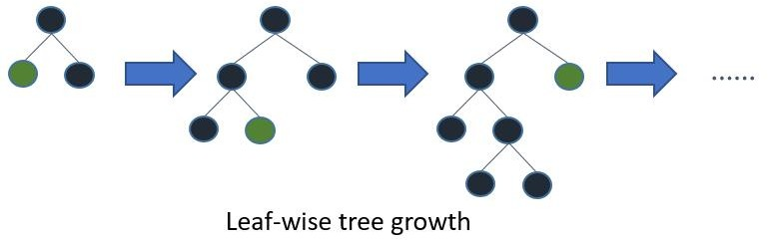
Aim 4: Building and Evaluating Model
LightGBM
LightGBM is a fast, distributed high performance gradient boosting framework.
LightGBM is based on decision tree algorithm. But it splits the tree leaf wise rather then level wise like other boosting algorithm. So when growing on the same leaf in Light GBM, the leaf-wise algorithm can reduce more loss than the level-wise algorithm and hence results in much better accuracy which can rarely be achieved by any of the existing boosting algorithms.
This model does not converge for our dataset

Slide 25
Conclusion
In this project, we tried to predict the trip duration of a taxi in NYC.
We did some feature engineering like adding new features and separate categorical and numerical features
We did hyperparameter tuning and optimization for models
XGBoost is the best model to predict the trip duration for a particular taxi.

